Slide 1
PROJECT PRESENTATION • DATA VISUALIZATION
Hospital Performance
Analytics Dashboard
Interactive hospital operations analysis using Tableau
Presented by: Yasaswini Pulamarasetti
DATA → INSIGHT → ACTION
HOSPITAL PERFORMANCE ANALYTICS • TABLEAU
01

Slide 2
Project overview
One Tableau workbook brings four operational views into a single navigable experience
01 HOSPITAL OVERVIEW
02 PATIENT FLOW
03 DEPARTMENT ANALYSIS
Summary KPIs, discharge status, age distribution, disease counts and monthly operational trends.
Patient count, average wait time and age, ward distribution, race, length of stay and discharge analysis.
Readmission by department, average satisfaction, referral counts and monthly length of stay.
04 RESOURCE UTILIZATION
INTERACTION
Yearly patient counts, bed occupancy and department-level resource measures.
Navigation buttons and filters connect the four views.
HOSPITAL PERFORMANCE ANALYTICS • TABLEAU
02

Slide 3
Problem statement & objectives
A consolidated visual interface supports easier exploration of hospital data
PROBLEM
OBJECTIVES
Hospital operational measures are spread across multiple charts and analytical views. Reviewing patient flow, department patterns, discharge outcomes and resource measures separately can make comparisons less convenient.
• Consolidate four dashboard views in one workbook
• Make navigation between views straightforward
• Enable filter-based exploration of selected categories
• Support chart-level comparisons
• Present trends and distributions clearly
Scope: the supplied workbook screenshots show a Tableau analytics project, not live hospital-system integration.
HOSPITAL PERFORMANCE ANALYTICS • TABLEAU
03

Slide 4
Data and measures shown
Fields and KPIs visible in the supplied Tableau screenshots
HOSPITAL OVERVIEW
PATIENT FLOW
Total admissions; occupancy rate; average length of stay; readmission rate; bed utilization rate; discharge status; age, disease and monthly trends.
Patient count; average wait time; average age; resource utilization; ward; race; average length of stay; discharge analysis.
DEPARTMENT ANALYSIS
RESOURCE UTILIZATION
Readmission by department; average satisfaction by department; department referral counts; monthly length of stay.
Year of admission date; yearly patient counts; bed occupancy; occupied-bed and available-bed measures; department tiles.
Use measures as represented in Tableau. Confirm units and KPI definitions against the source data before making operational claims.
HOSPITAL PERFORMANCE ANALYTICS • TABLEAU
04

Slide 5
Project workflow
From source fields to interactive Tableau dashboards
01
02
03
04
05
Data fields
›
Prepare
›
Analyze
›
Visualize
›
Interact
Hospital, patient,
department and resources
Check field types, dates,
categories and missing values
Build KPI views, counts,
comparisons and trends
Arrange charts into
four dashboard layouts
Add navigation, filters
and chart actions
PRIMARY TOOL
Tableau Desktop — used to build and connect the four dashboard views.
HOSPITAL PERFORMANCE ANALYTICS • TABLEAU
05

Slide 6
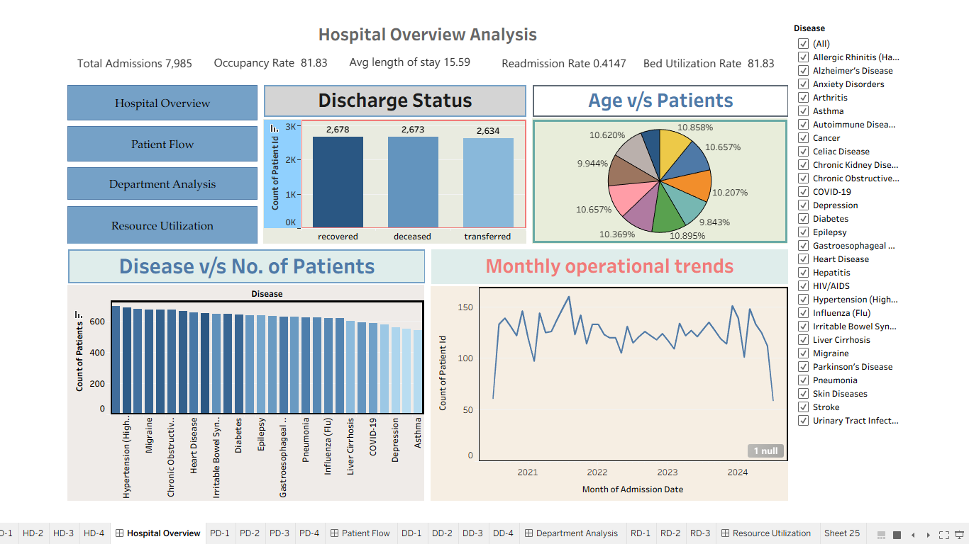
Dashboard 1 · Hospital Overview
Hospital-wide indicators, outcome distributions and operational trends
WHAT IT SHOWS
The screenshot shows total admissions 7,985; occupancy rate 81.83; average length of stay 15.59; readmission rate 0.4147; bed utilization rate 81.83; plus discharge, age, disease and monthly-trend charts.
HOW TO EXPLORE
Use the Disease filter to explore disease-related views. Navigation buttons switch dashboards.
ANALYTICAL FOCUS
Review KPI summaries, discharge categories, disease counts and trends over admission dates.
HOSPITAL PERFORMANCE ANALYTICS • TABLEAU
06

Slide 7
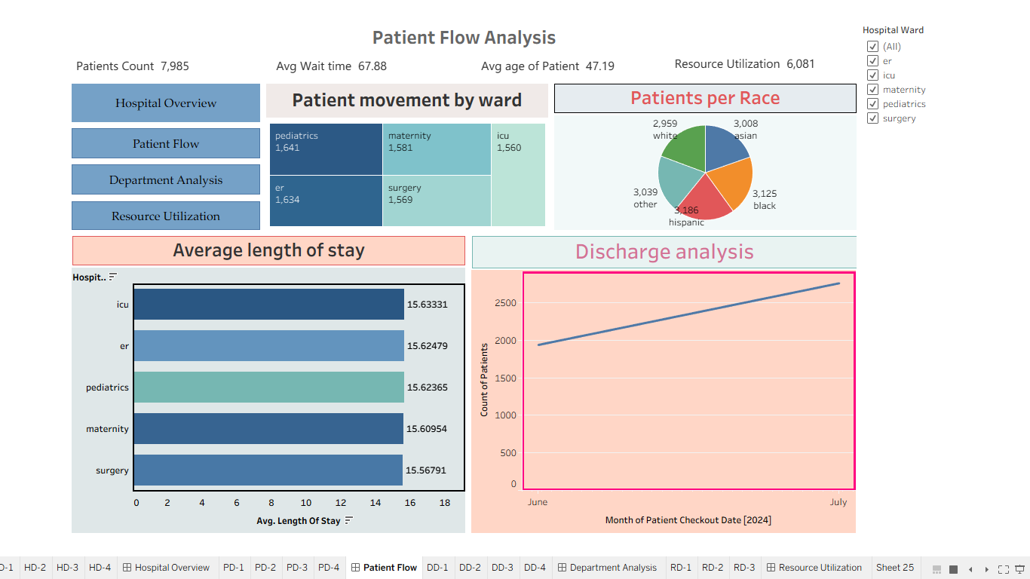
Dashboard 2 · Patient Flow
Patient counts, ward distribution, wait time and discharge patterns
WHAT IT SHOWS
The screenshot shows patient count 7,985, average wait time 67.88, average age 47.19 and resource utilization 6,081, alongside ward, race, length-of-stay and discharge charts.
HOW TO EXPLORE
Use the Hospital Ward filter to explore ward categories. Navigation buttons switch views.
ANALYTICAL FOCUS
Compare ward-level patient counts and displayed length-of-stay and discharge patterns.
HOSPITAL PERFORMANCE ANALYTICS • TABLEAU
07

Slide 8
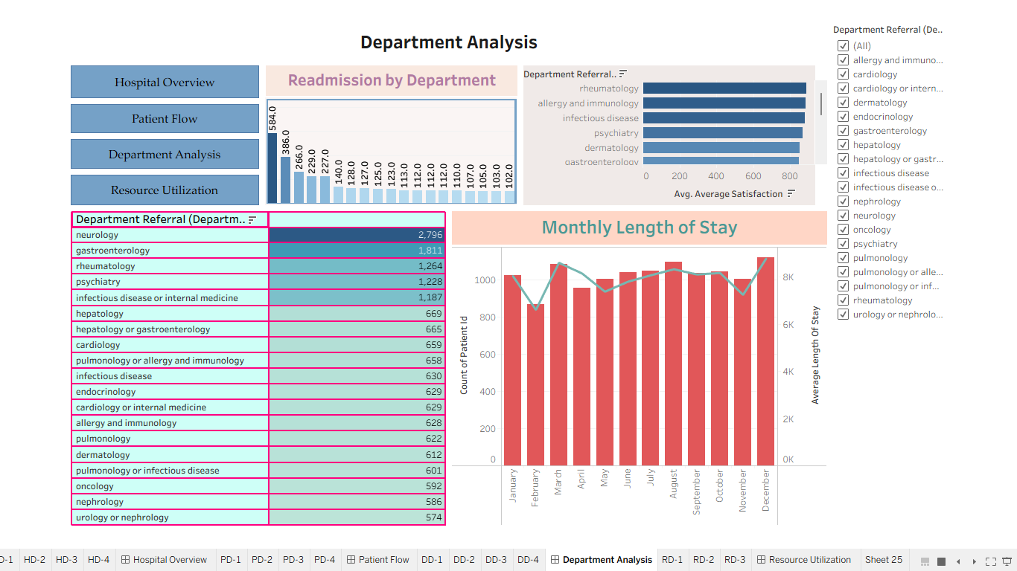
Dashboard 3 · Department Analysis
Department readmission, satisfaction, referral and monthly stay views
WHAT IT SHOWS
The screenshot includes readmission by department, average satisfaction by department, department referral counts and monthly length of stay.
HOW TO EXPLORE
Use the Department Referral filter to focus on selected categories. Navigation buttons switch views.
ANALYTICAL FOCUS
Compare department referral counts and readmission patterns; review satisfaction and monthly stay measures.
HOSPITAL PERFORMANCE ANALYTICS • TABLEAU
08

Slide 9
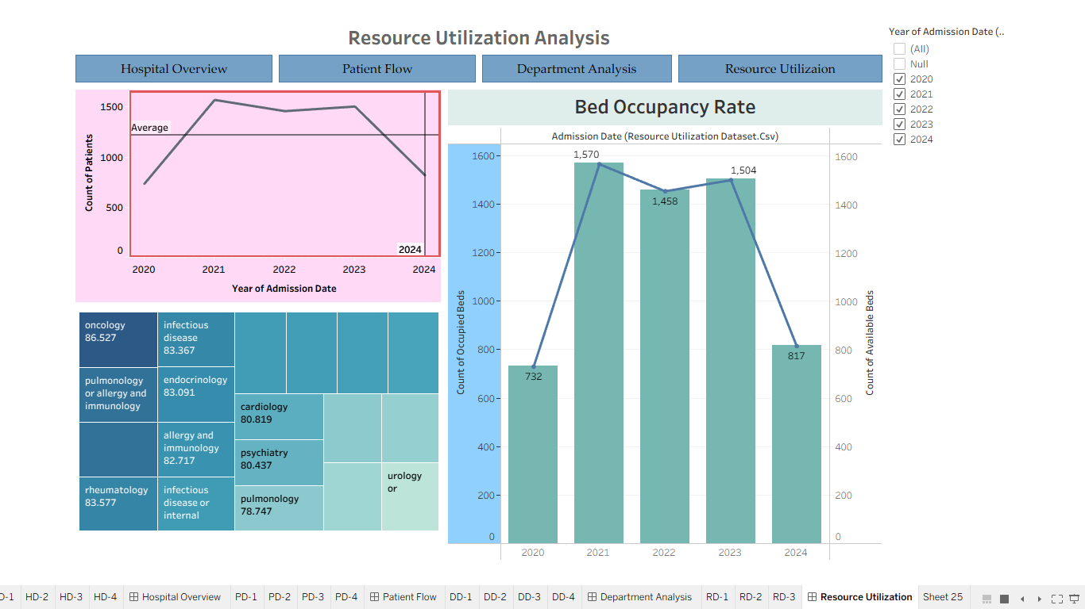
Dashboard 4 · Resource Utilization
Yearly patient counts, bed occupancy and department-level resource measures
WHAT IT SHOWS
The screenshot shows yearly patient counts from 2020–2024, bed-occupancy chart with occupied and available bed measures, and department-level tiles.
HOW TO EXPLORE
Use the Year of Admission Date filter to focus on selected years. Navigation buttons switch dashboards.
ANALYTICAL FOCUS
Explore how displayed resource measures and patient counts vary across years and departments.
HOSPITAL PERFORMANCE ANALYTICS • TABLEAU
09

Slide 10
Interactive navigation & filters
Move between views and narrow the displayed data
NAVIGATION BUTTONS
DASHBOARD FILTERS
CHART ACTIONS
Four buttons link to Hospital Overview, Patient Flow, Department Analysis and Resource Utilization.
Visible filters include Disease, Hospital Ward, Department Referral and Year of Admission Date.
Configured chart actions can filter related views when a mark is selected; verify behavior in Tableau.
Hospital Overview
Patient Flow
Department Analysis
Resource Utilization
Screenshot evidence confirms visible filters and navigation; test each filter and action in the live workbook.
HOSPITAL PERFORMANCE ANALYTICS • TABLEAU
10

Slide 11
Observations from the dashboard
Descriptive points visible in the supplied screenshots
PATIENT FLOW
HOSPITAL OVERVIEW
DEPARTMENT VIEW
Displayed patient count: 7,985. Average wait time: 67.88; the unit is not visible in the screenshot.
Displayed average length of stay: 15.59. Confirm its unit and calculation definition in the source data.
The visible referral-count table lists neurology at 2,796 and gastroenterology at 1,811.
RESOURCE VIEW
RESPONSIBLE INTERPRETATION
The bed-occupancy chart shows years 2020–2024; the screenshot alone does not explain why values change.
These are dashboard observations, not proof of clinical quality or hospital-wide performance without validated definitions.
HOSPITAL PERFORMANCE ANALYTICS • TABLEAU
11

Slide 12
Thank You!
Questions & Discussion
Hospital Performance Analytics Dashboard

